Slide 1
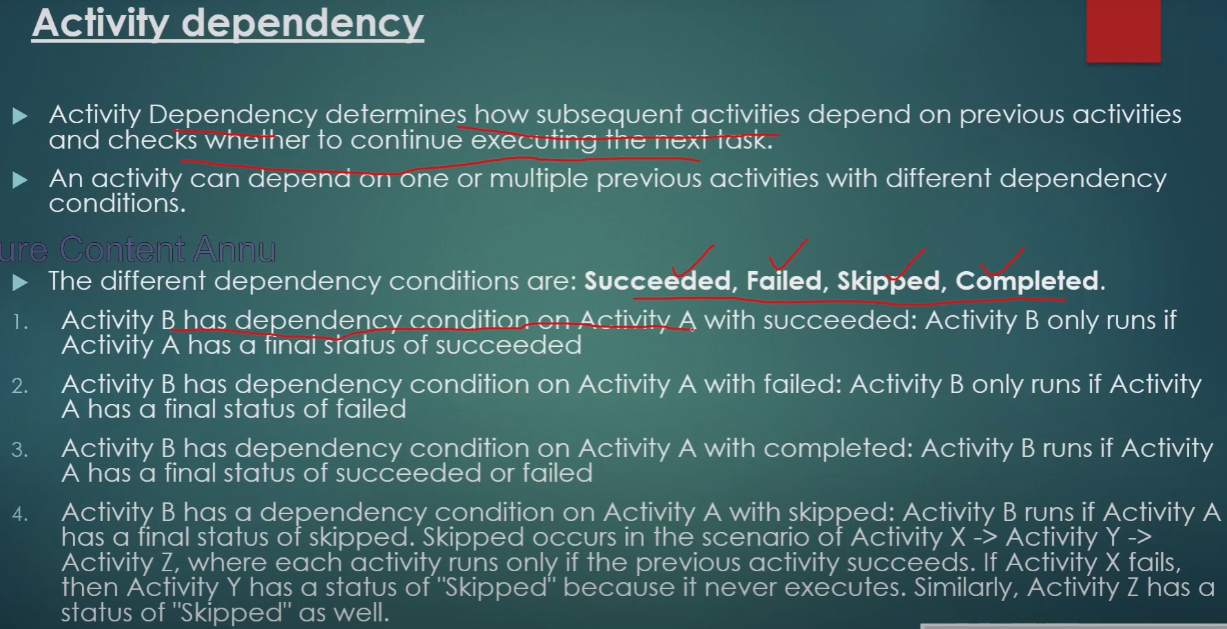

Slide 2
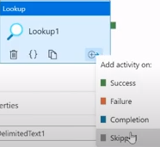
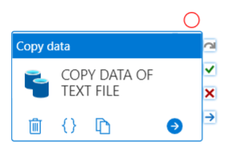
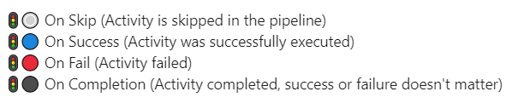
On Skip
On Success
On fail
On Completion

Slide 3
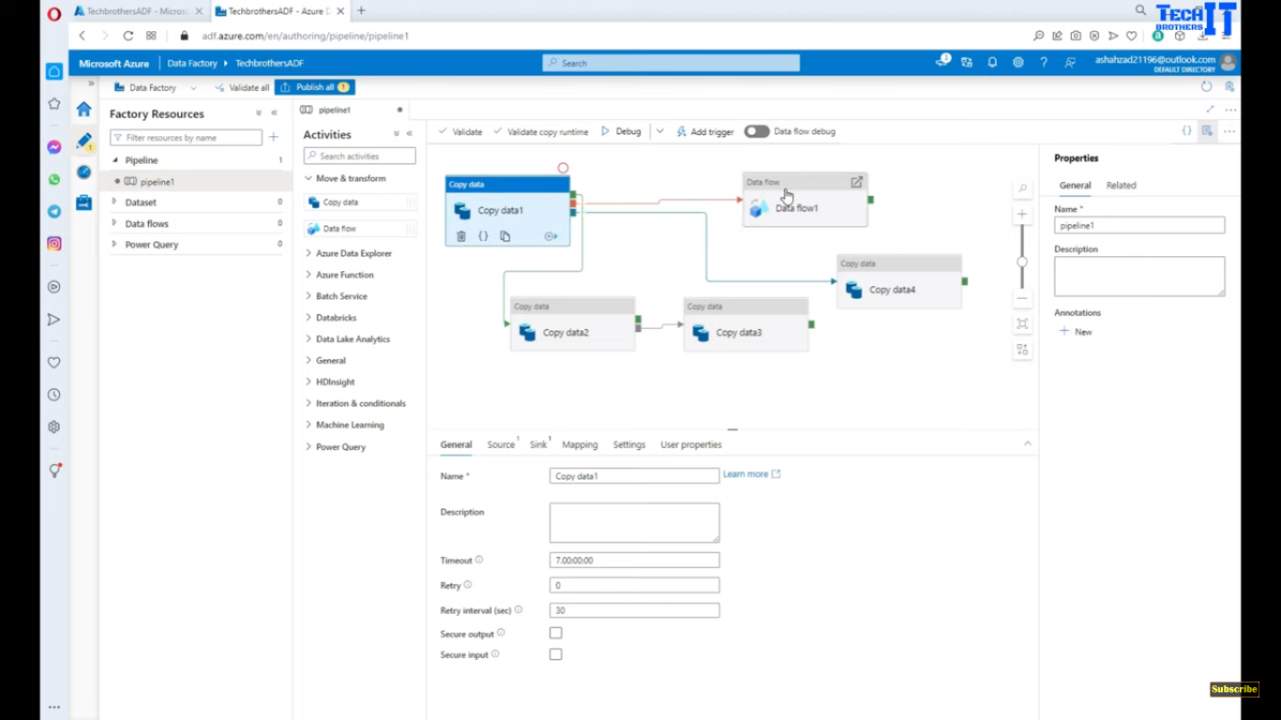
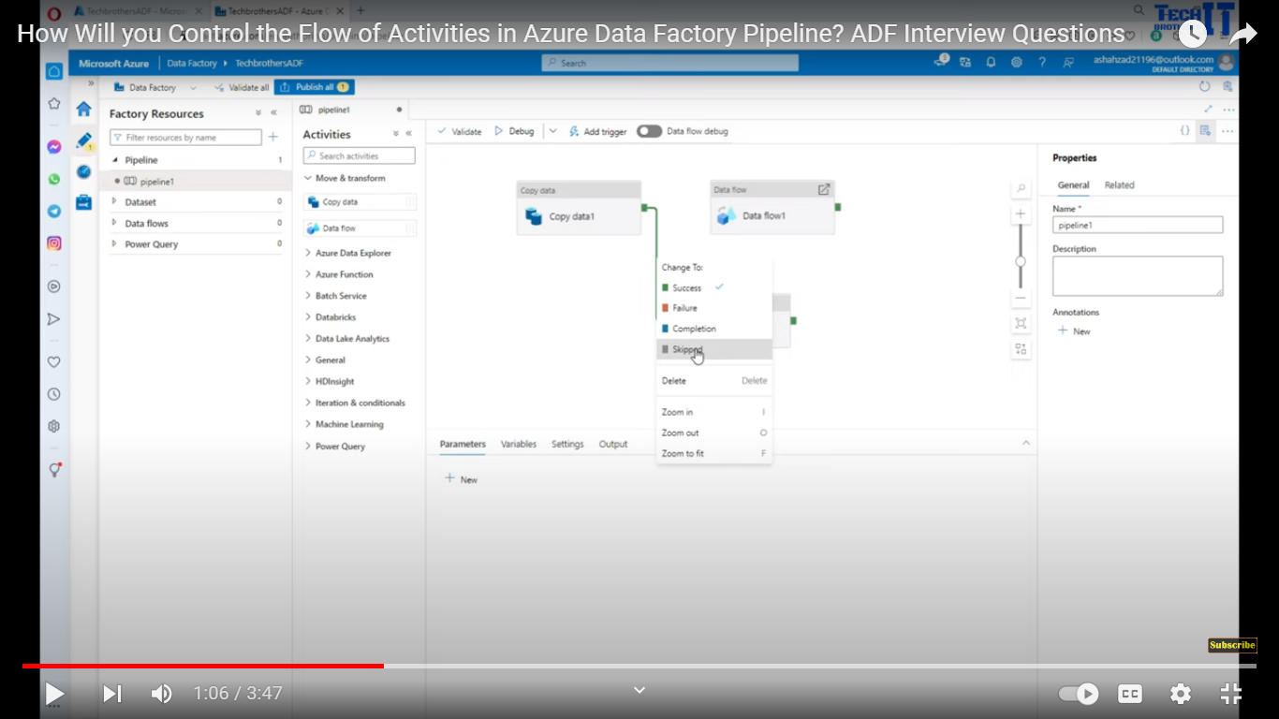

Slide 4
Success

Slide 5
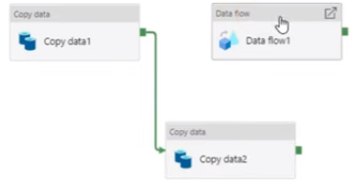
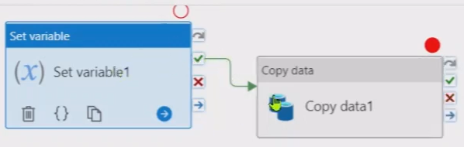
If Copy data1 completes successfully then it will go to Copy data2

Slide 6
Failure

Slide 7
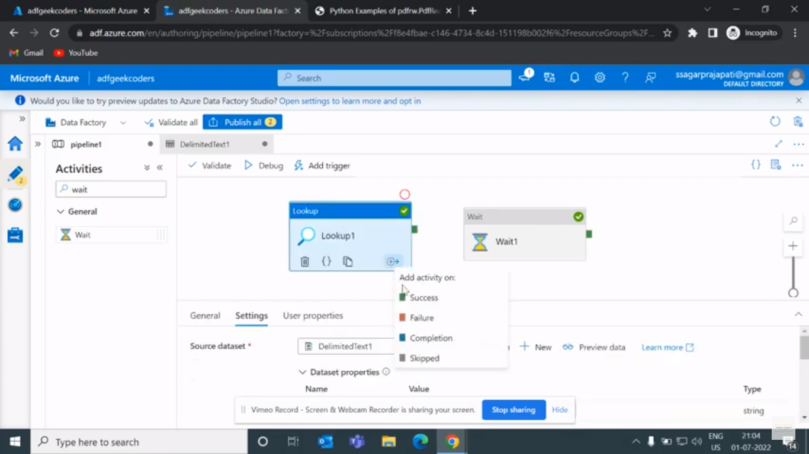
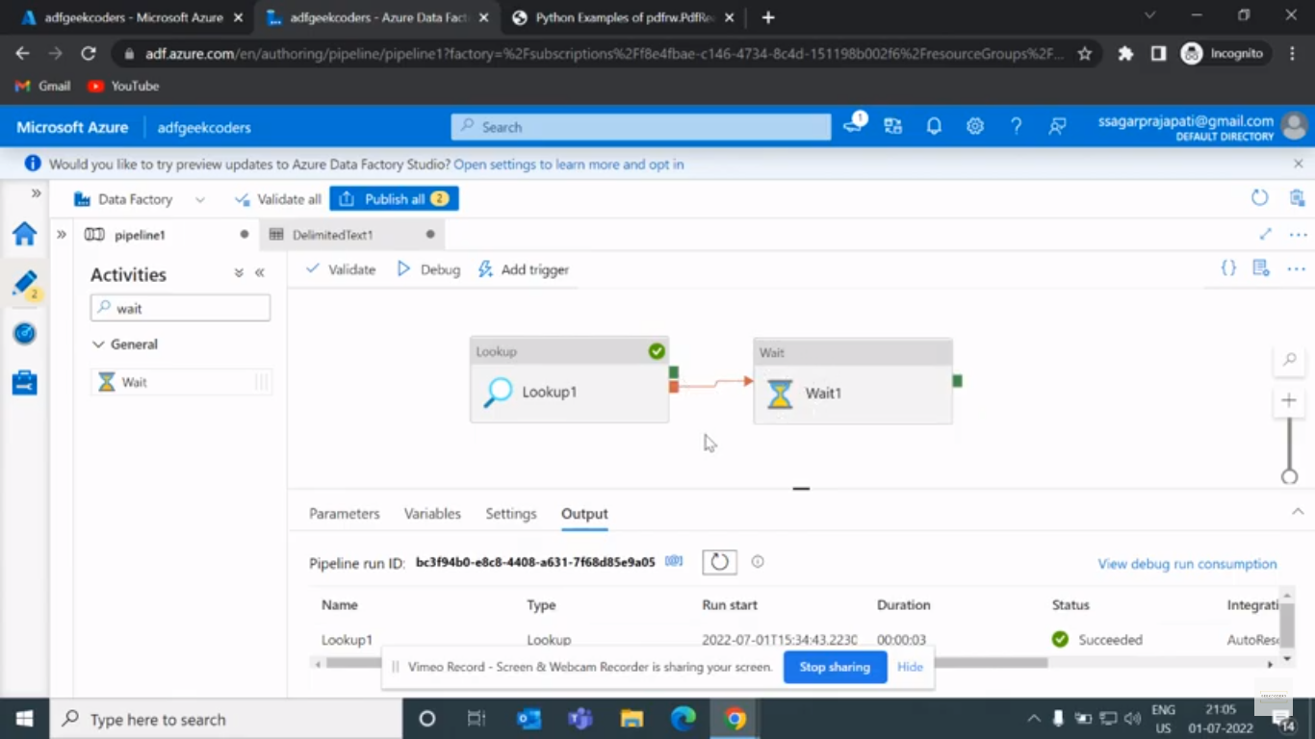
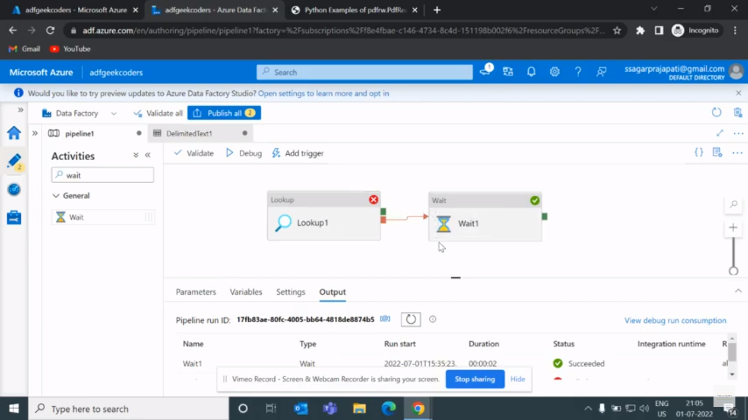
Lookup activity completed successfully. Since we put failure, wait activity got skipped.
Lookup activity failed even though Since we put failure, wait activity got triggered.

Slide 8
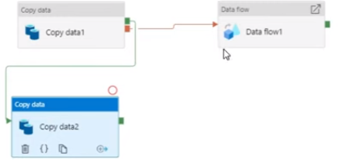
If Copy data1 activity completes then it goes to Copy data2.
If Copy data1 activity failes then it goes to Data flow1.

Slide 9
Completion

Slide 10
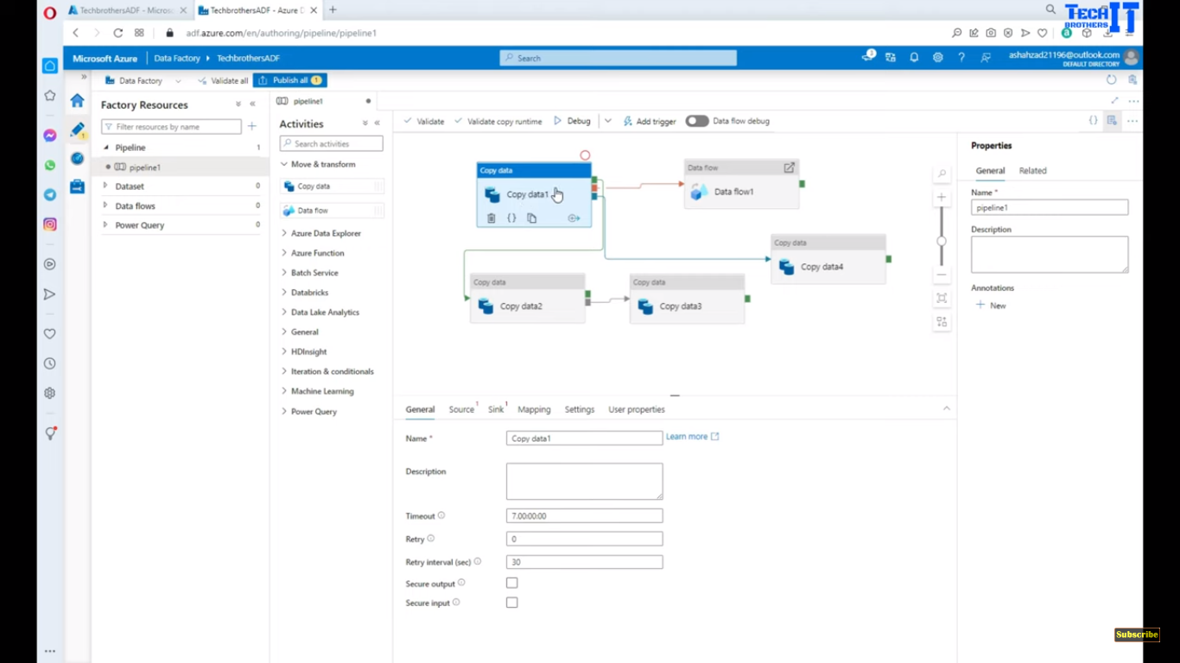
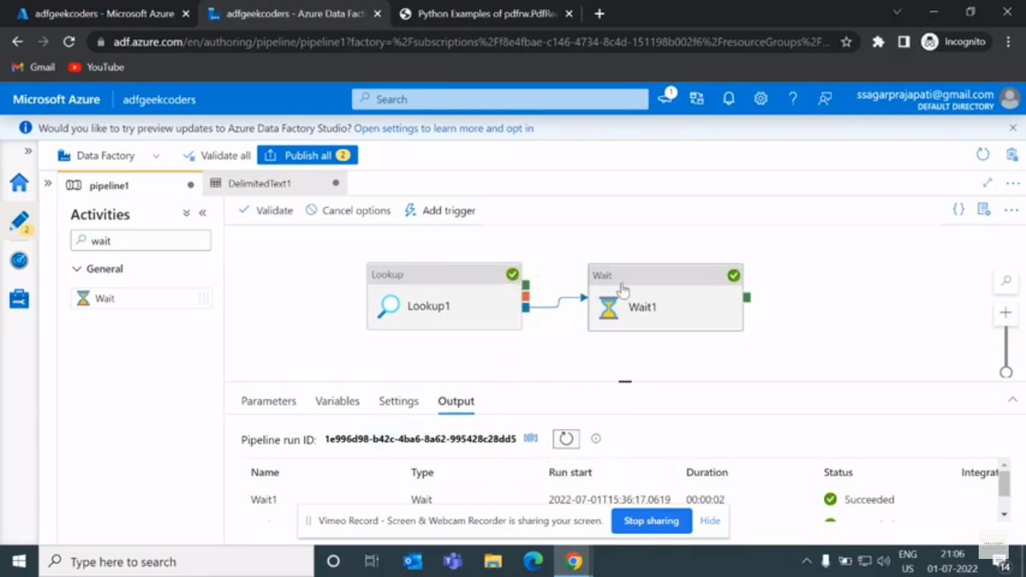
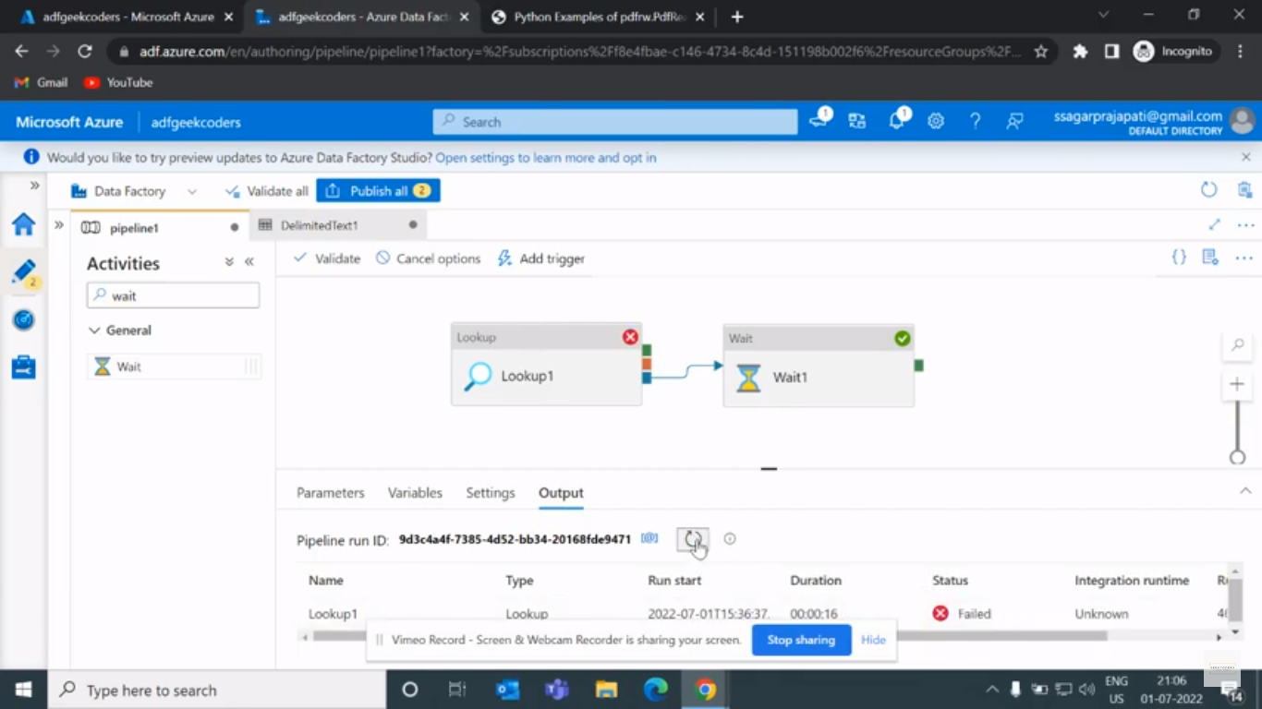
Whether it is passed / failed (Copy data1) it does not matter, if it completes it will get trigger to Copy data4.
Whether it is passed / failed it does not matter, if it completes it will get trigger.

Slide 11
Skipped

Slide 12
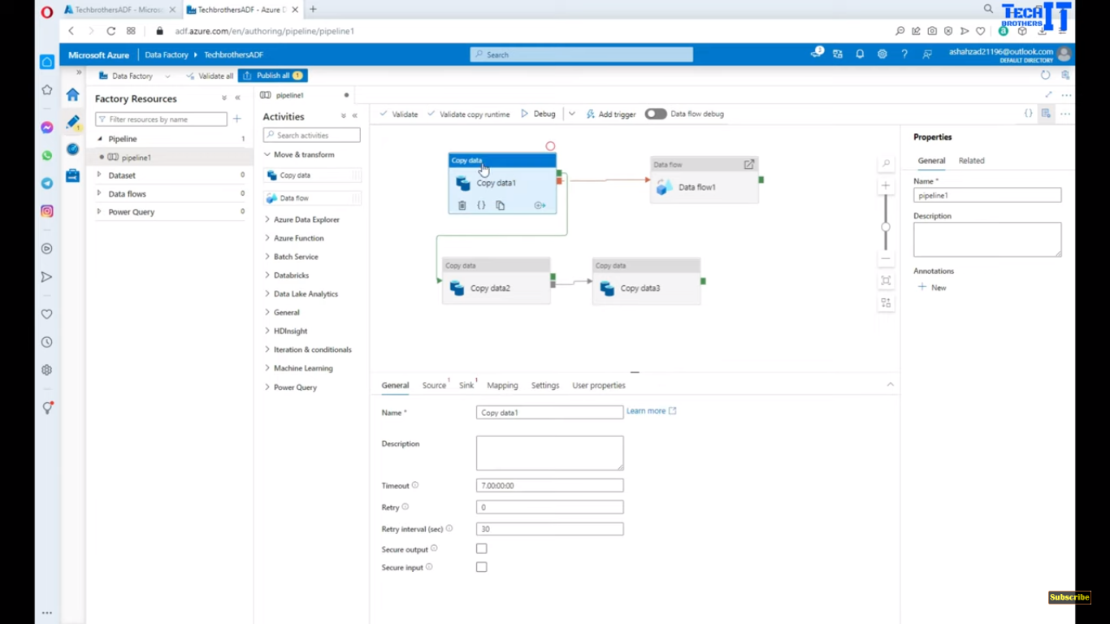

1) If Copy data1 activity completes then it goes to Copy data2 but since
it mentioned as skipped(skips Copy data2) it triggers for Copy data3.
2) If Copy data1 activity failes then it goes to Data flow1.
I do not want to run this wait activity. Since we mentioned skipped, Wait activity won’t run.

